Slide 1
Good Morning
How To Make Better Capital Spending Decisions
Professor: Phil Watlington
University Saint Mary
Division of Business & Information Technology
Finance & Accounting Program Director
Spires Trading Team Coach

Slide 2
Phil Watlington, Author

Slide 3
Entrepreneurship, Finance & Accounting

Slide 4
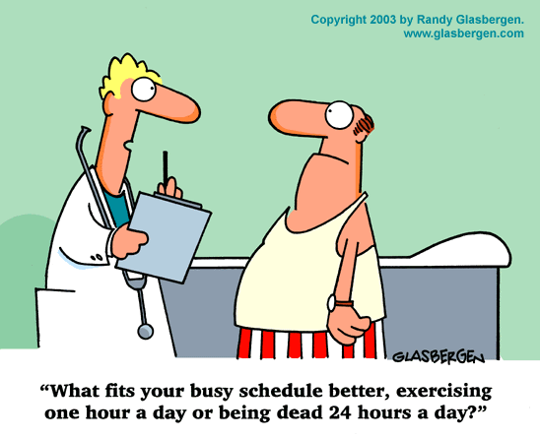

Slide 5
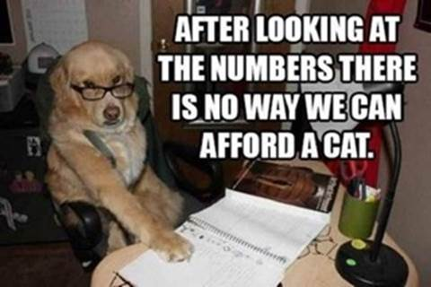

Slide 6
How To Make Better Capital Spending Decisions
“The age of cheap money is over. In the face of rising capital costs, leaders should rethink their approach to resource allocation and capital planning. These processes must become more disciplined and dynamic” (Mankin, 2023).
Mankins, M. (2023). Capital is Expensive Again, Now What? Harvard Business Review. https://hbr.org/2023/03/capital-is-expensive-again-now-what

Slide 7
Informed Decision-Making
CAPITAL SPENDING ANALYSIS
Purchase – Facility Network Computer System
(Dollars in Thousands) Cost Yr 1 Yr 2 Yr 3 Totals
Cost (Investment) $ 200
Net Savings $ 75 125 138 $ 338.0
Discount Factor (12%) .8929 .7972 .7118
Present Value $ 67.0 99.7 98.2 $ 264.9
Net Present Value (NPV) = $264.9 - $200 = $64.9 Positive NPV
Payback (Years) – Disc. = $200 / ($264.9/3) = $200/88.3 = 2.3 yrs
Payback (Years) – Not Disc. = $200 / ($338/3) = $200/112.7 = 1.8 yrs
Return on Invest (ROI) = $64.9/$200 = 32.5%/3 = 10.8% avg. year

Slide 8
Thank You
This High Finance Stuff Drives Me Crazy? I prefer the See It, Like It, Buy It approach!

